Slide 1

ObfusLock: An Efficient Obfuscated Locking Framework for Circuit IP Protection
You Li*, Guannan Zhao*, Yunqi He, and Hai Zhou
Northwestern University
DATE’23
*Equal Contribution
Notes:
Hi, in this video we will introduce ObfusLock, a new logic encryption method which addresses some key issues within existing methods. I am You Li from Northwestern University and this work is done in collaboration with Guannan Zhao, and supervised by Professor Hai Zhou.
===
[Subject to fixes from human, Grammarly, GPT, etc.]
Hello everyone,
We introduce a novel framework for “locking” and protecting hardware intellectual properties, which we call ObfusLock. This name comes from our way of combining structural obfuscation with traditional key-based logic encryption.

Slide 2
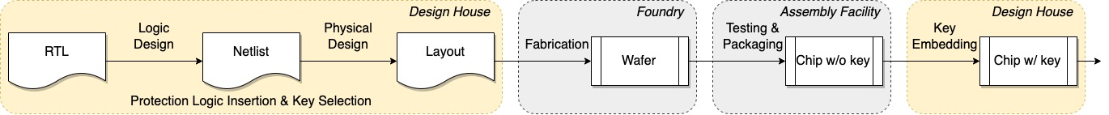
Logic Encryption
Logic locking embeds key-controlled protection logic bits to the netlist of the original circuit.
The encrypted circuit can operate normally only if a correct key is in presence.
Notes:
Logic encryption is a technique to protect the intellectual property of a chip. Without knowing a correct key, a malicious user cannot fully recover the functionalities of the chip. Technically, a logic encryption method adds certain key-controlled logics to the netlist of the original circuit. After the chip is fabricated and returned to the design house, the key is inserted to activate the chip.
===
But what is logic encryption, and why do we need it in the first place? Because it is too easy for bad guys to steal a hardware design without protection. For example, they can simply scan the chips with a microscope to get a copy of the original netlist. This leads to a lot of security and privacy challenges, including IP piracy, counterfeiting, reverse engineering, and even the insertion of hardware Trojans.
And what makes things worse is the outsourcing of hardware manufacturing, as shown in the picture. If the design house just sent the original physical layout to untrusted parties for fabrication and assembly, the secret would be immediately leaked. So how can we protect the original design?
Logic encryption focuses on the netlist level. Early logic locking techniques insert additional key-controlled gates to the original circuit. This results in an encrypted circuit that operates normally only if a correct key is provided. The untrusted parties would manufacture the encrypted chips as usual, without knowing the correct key. As the final step, the design house can then embed the correct key into a tamper-proof memory.

Slide 3
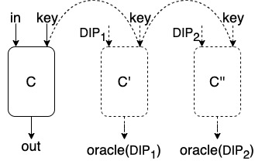
The SAT-based Attack
Encode the netlist as CNF/SMT formulas.
Require an oracle circuit purchased from the market.
In every iteration, call a SAT/SMT solver for a differentiate input pattern (DIP). Given this DIP, two different keys will produce two different outputs.
Query the oracle for the corresponding output. Enforce the DIP/oracle(DIP) pair to eliminate
all incorrect keys associated with the
DIP.
P. Subramanyan, S. Ray, and S. Malik, “Evaluating the security of logic encryption algorithms,” in HOST’15
Notes:
Now let us review some attacks against logic encryption. The first type of attack is the SAT attack. Ths attack assumes that the attacker has access to an encrypted netlist and a working chip. The SAT attack iteratively rules out incorrect keys using input and output observations. Finally, a correct key is extracted from the formal model.
We say that a logic encryption method is locking robust if it can effectively counter the SAT attack.
===
The subsequent question is, “can attackers search for the correct key efficiently?”
About eight years ago, the SAT-based attack is proposed. It assumes that the attackers have access to an encrypted netlist, so they can encode the netlist as CNF or SMT formulas. It additionally requires an oracle circuit purchased from the market, so they can query the correct output for each single input.
In the high level, the SAT attack incrementally prunes out incorrect keys until only correct ones are left. In every iteration, it calls a SAT/SMT solver for a differentiating input pattern, or DIP. Given this DIP, two different keys will produce two different outputs. It then query the oracle for the correct output. This new information is then added to the SAT/SMT solver, eliminating at least one incorrect key associated with the DIP. In fact, with early encryption methods, usually much more keys can be eliminated at once.

Slide 4
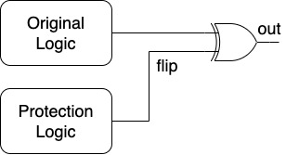
Structural Attack
Using static structural analysis, dynamic analysis or machine learning-based analysis to distinguish the critical wire/component within the netlist.
Then remove/bypass the distinguished part to recover original functionality.
Notes:
The second type of attacks is the structural attacks. These attacks make use of structural information within the netlist to distinguish the critical wires or modules and then remove them.
We say that a logic encryption method is locking robust if it can resist structural attack.
===
In order to defend against the SAT-based attack, some new logic encryption methods are proposed. For example, single-flip defences add a protection logic to flip the primary outputs when an incorrect key is inserted, as shown in the picture. However, such methods are vulnerable to structural attacks.
Using static structural analysis, dynamic analysis, or machine learning-based analysis, one can distinguish the critical wire within the netlist, and then remove or bypass the distinguished part to recover original functionality.

Slide 5
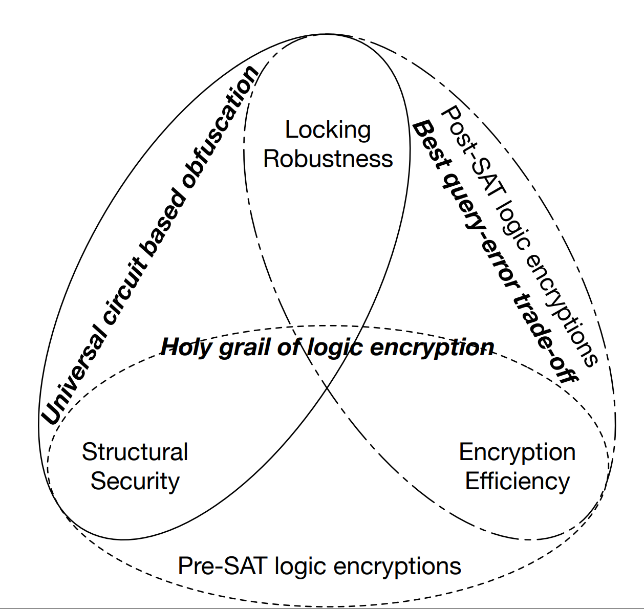
Trilemma in Logic Encryption
A logic locking scheme is efficient if it introduces minimum power, performance and area (PPA) overheads and requires an adequate number of key bits.
In previous works, locking robustness (SAT-attack resilience), structural robustness (structural attack
resilience) and efficiency can not be
achieved simultaneously.
H. Zhou, “A humble theory and application for logic encryption”
Notes:
A logic encryption is efficient if it introduces only minimal power, performance and area overheads.
In conclusion, there are three main objectives for logic encryption, namely, locking robustness, structural robustness, and efficiency. According to a previous article, there is a trilemma among the three objectives. In other words, none of the existing work can achieve these three objectives simultaneously.
===
Researchers have recognized the resilience to SAT-based attacks and to structural attacks as conflicting goals. Furthermore, a previous work shows the trilemma among locking robustness, structural robustness, and efficiency. A logic encryption scheme is efficient if it introduces minimum power, performance and area overheads and requires a reasonable number of key bits. Efficiency is especially crucial for protecting the hardware designs where the majority of work is devoted to optimization.
But as far as we are concerned, no previous works was successful in achieving these three goals at the same time. And this is what we aim to achieve, with ObfusLock.

Slide 6
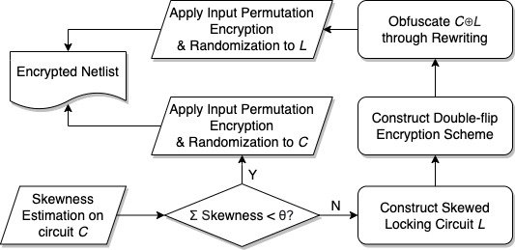
The Overview of ObfusLock
ObfusLock aims at achieving 3 objectives simultaneously:
  Constructing a highly skewed locking logic with the nodes in the original logic and applying input permutation encryption (to ensure locking robustness);
  Adopting double-flip locking scheme and applying rewriting (to ensure structural robustness);
  Emphasizing efficiency in the
above two steps.
Notes:
Here is an overview of ObfusLock.
It first constructs a highly skewed locking circuit with the nodes within the original circuit, and apply input permutation encryption. This guarantees locking robustness.
It then use the double-flip locking scheme and structural and behavioral rewriting to achieve structural robustness.
And it always put an emphasis on locking efficiency.
We will explain all the points one by one in next slides. Now let us welcome Guannan Zhao to discuss the next part.
===
Here is the overview of ObfusLock.
Firstly, to ensure locking robustness, we construct a highly skewed locking logic with the nodes in the original logic and apply input permutation encryption. We have formally proved the input permutation encryption is resilient to SAT-based attacks.
Secondly, to ensure structural robustness, we adopt the double-flip locking scheme and then apply our customized rewriting rules to obfuscate the original logic and the locking logic.
And lastly, we emphasize efficiency in the above two steps.
We will elaborate on these three points, one by one.

Slide 7
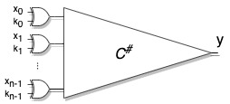
Ensuring Locking Robustness
A node is skewed if it has only an exponentially small probability to output a 0 (resp. 1).
ObfusLock constructs a skewed locking logic using the nodes in the original logic, and then inserts XOR gates to the primary inputs of the locking logic (input permutation encryption).
Notes:
Hi, this is Guannan Zhao and I will explain more technical details to you.
The key to ensuring locking robustness is to construct a skewed circuit. We say a node is skewed, if it has only an exponentially small probability to output a zero, or inversely, a one.
Obfuslock constructs a skewed locking logic using the nodes in the original logic, and then inserts XOR gates to the primary inputs of the locking logic, as shown in the picture. These key-controlled XOR gates effectively performs a permutation on the input-output mappings. So how does it defend against SAT-based attacks?
Informally speaking, SAT-based attacks search for input patterns where different keys disagree. Since the circuit is skewed, disagreement is rare. And due to the permutation, an input pattern that eliminates a key is very unlikely to also eliminate another. This downgrades SAT-based attacks toward brute-force key elimination.

Slide 8
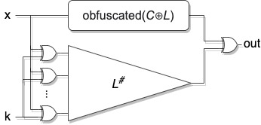
Ensuring Structural Robustness
The locking logic is XORed twice with the original logic.
By obfuscating the critical nodes (C and L), we achieve robustness against removal attacks and bypass attacks.
ObfusLock conducts a combination of structural and functional rewriting steps to transform the critical nodes.
  Decomposition
  Propagation
  Elimination
Notes:
This skewed locking circuit – we just talked about – is XORed /eks-ou-ard/? twice with the original logic: firstly without the key-controlled gates, which we denote as L in the picture; and secondly with the key-controlled gates, which we denote as L-sharp. Since L is not protected by keys, attackers can still launch a structural attack to restore the original circuit functionality.
To solve this problem, we obfuscate L with the original circuit C, so they are no longer identifiable. Our basic idea is to conduct a combination of customized structural and functional rewriting steps to transform the critical nodes. To start, we decompose the critical nodes and its activity into multiple nodes. We then propagate these decomposed nodes so that they are spread in the netlist. And finally, we merge, eliminate, or substitute these decomposed nodes. This is how we ensure structural robustness.

Slide 9
Ensuring Efficiency
Small number of key bits:
  Locking robustness increases exponentially with respect to the number of key bits.
Negligible delay increase:
  The locking circuit is parallel to the original circuit and introduces little or no extra delay.
Low area/power increase:
  With proper sub-circuit selection, the locking circuit is substantially small compared to the original circuit.
  During structural transformation, logic sharing occurs for the locking circuit and the original circuit.
Notes:
We now talk about how efficiency is ensured.
Firstly, our protection only needs a small number of key bits. This is due to locking robustness increasing exponentially with respect to the number of key bits.
Secondly, our protection hardly add any delay to the original circuit, because the locking circuit is parallel to the original circuit.
Thirdly, our protection only introduces a little area and power overhead, which is positively correlated with the number of gates in the circuit. And with proper sub-circuit selection, our locking circuit can be made substantially small compared to the original circuit. And the logic sharing during structural transformation further decreases the area-power overhead.

Slide 10
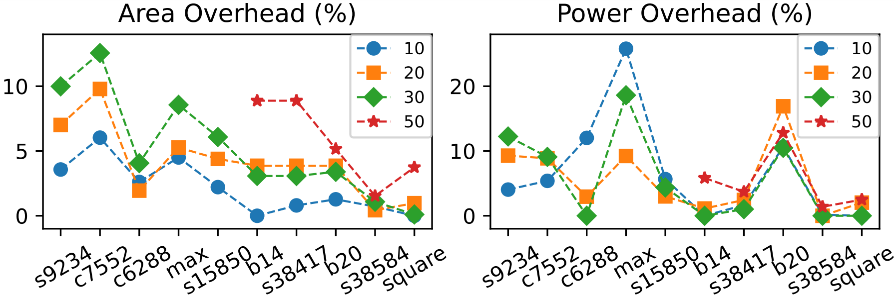
Evaluation
ObfusLock is secure against SAT-based attacks.
  All attacks timeout with 20 bits of skewness.
ObfusLock is secure against structural attacks.
  Neither Valkyrie or SPI attack was successful in decryption.
ObfusLock incurs a reasonable overhead.
  Area average: 4.0%
  Power average: 4.9%
  Delay average: 0.07%
Notes:
Finally, we briefly show our experimental results.
We have firstly verified that ObfusLock is secure against SAT-based attacks. With twenty bits of skewness, no variant of the SAT-based attacking methods was able to solve a correct key within the time limit.
We have also made sure that ObfusLock is secure against the most up-to-date structural attacks, namely Valkyrie and the SPI attack. Additionally, we analyzed, with a case study, how the critical signals are decomposed and spread out.
And lastly, we have measured the overhead incurred by Obfuslock. The average area and power overhead is less than five percent, and the delay overhead is negligible. Our results have confirmed the strong security guarantees of our framework.
Thank you for your attention.

