Slide 2

Evaluating the Security of Logic Locking on Deep Neural Networks
Northwestern University, USA
You Li*, Guannan Zhao*, Yunqi He, and Hai Zhou
*Equal Contribution
Notes:
Thank you for the introduction. In this talk we will discuss the security of deep neural networks from a hardware perspective. Specifically, we evaluate whether the existing logic locking techniques are secure on deep neural networks.
I am You Li, and this work is done in collaboration with Guannan Zhao and supervised by Professor Hai Zhou.

Slide 3
Security Threats to AI Systems
1. Intellectual property (IP) piracy
  Replicate the model without the permission of the owner.
2. Extract sensitive training data
  Model inversion attack
  Membership inference attack
3. Abuse or deceive the DNN model
  Adversarial attack
  Data poisoning attack
Notes:
Training a deep neural network requires time, effort, data, and expertise. The network architecture are usually public knowledge, but the network parameters are usually private intellectual property.
The security threats to a deep neural network can be classified into three categories. IP piracy aims at replicating the model without permission of the IP owner. Model inversion attack and membership inference attack aim at inferring sensitive training data through queries to the model. Adversarial attack and data poisoning attack aim at abusing or deceiving the model.

Slide 4
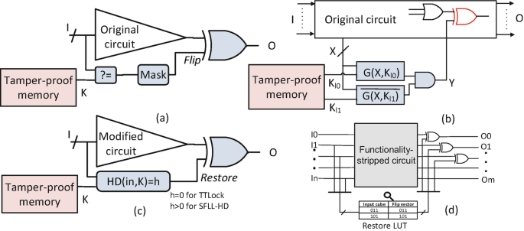
Logic Locking on Integrated Circuits
Logic locking leverages hardware root-of-trust to protect integrated circuits.
Logic locking embeds binary key bits into the netlist or the physical layout of a circuit.
  The key bits are stored in a tamper-proof memory or a trusted platform module on hardware.
  Without knowing the correct key, an adversary cannot recover the original functionality.
A Brief History of Logic Locking. Muhammad Yasin, JV Rajendran and Ozgur Sinanoglu.
Notes:
Logic locking is an emerging technique to protect integrated circuits.
It inserts binary key bits into the circuit netlist or the physical layout. Those key bits are stored in a tamper-proof memory or a trusted platform module on hardware. They cannot be retrieved even with physical access to the hardware.
An adversary cannot recover the original functionality of the circuit without knowing the correct key. Therefore, logic locking can resist nearly all kinds of attacks.

Slide 5
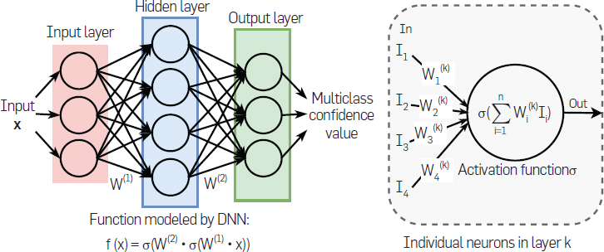
Logic Locking on DNNs
Logic locking can be extended to DNNs by treating a DNN (network of neurons) as a circuit netlist (a network of logic gates).
A combination of an AI hardware and an embedded correct key serves as a license to access the service provided by the IP owner.
Notes:
So how could logic locking be applied to deep neural networks? Actually a neural network is a network of neurons, whereas a circuit netlist is a network of logic gates.
To protect the IP of a deep neural network, an AI accelerator and a pre-installed key serve as the license to access the service provided by the IP owner. Future parameter updates can be released publicly on the cloud. Only the subscribers who have acquired valid licenses can use the neural network.

Slide 6
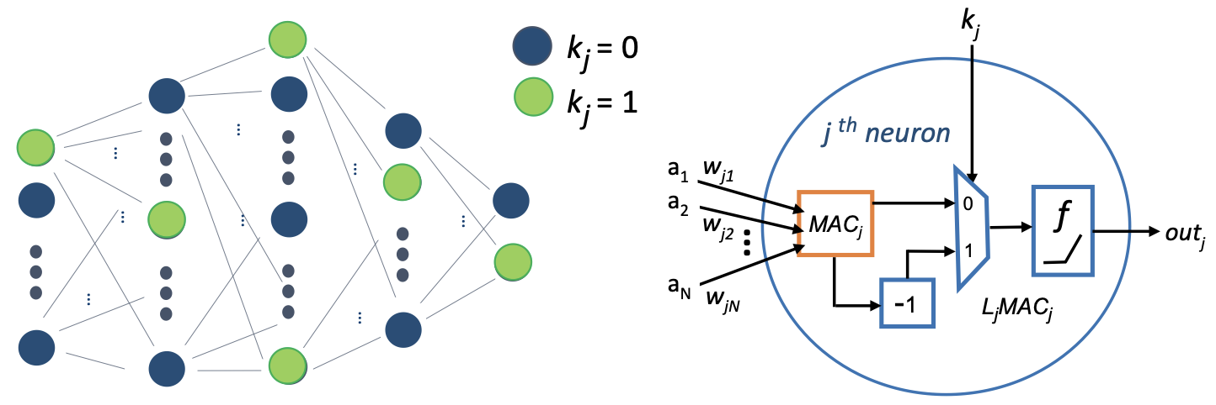
Functional logic locking of DNNs
Hardware protected neural network (HPNN) is the state-of-the-art technique for DNN logic locking.
Each key bit controls whether to flip the pre-activation value of a neuron.
A DNN model is trained as a function of the pre-selected correct key.
Hardware-Assisted Intellectual Property Protection of Deep Learning Models. Abhishek Chakraborty, Ankit Mondal, and Ankur Srivastava. In DAC 2020.
Notes:
Hardware protected neural network, or HPNN, is the state of the art technique for deep neural network logic locking.
It chooses a small subset of neurons in the hidden layers as the protected neurons. Then it associates a key bit to each of these neurons. Each key bit controls whether to negate the pre-activation value of a protected neuron.
A deep neural network model is trained as a function of the correct key selected by the IP owner. In this way, key bits and model parameters are closely entangled.
In the general case, a defender can choose another arithmetic operation instead of negation, or modify another signal in a neuron instead of the pre-activation value.

Slide 7
Adversarial Model
The adversary can be:
  A malicious end-user
  A malicious cloud service provider.
The adversary is capable of:
  Downloading the model architecture and all the model parameters.
  Obtaining a working DNN as the oracle.
  Querying the oracle for arbitrary inputs and observe the corresponding logits or output vectors.
The adversary’s objective is:
  Infer the correct key.
Notes:
We use the standard adversary model for logic locking. An adversary can be either a malicious end-user or a malicious cloud service provider.
Just like a normal user, the adversary can download the model. It can also purchase a license from the open market and use it as a running oracle. It can query the oracle with any inputs and observe the corresponding output vectors.
The adversary wants to find the correct key.
Compared with HPNN, our adversary model is even weaker because it does not need to access any training data.

Slide 8
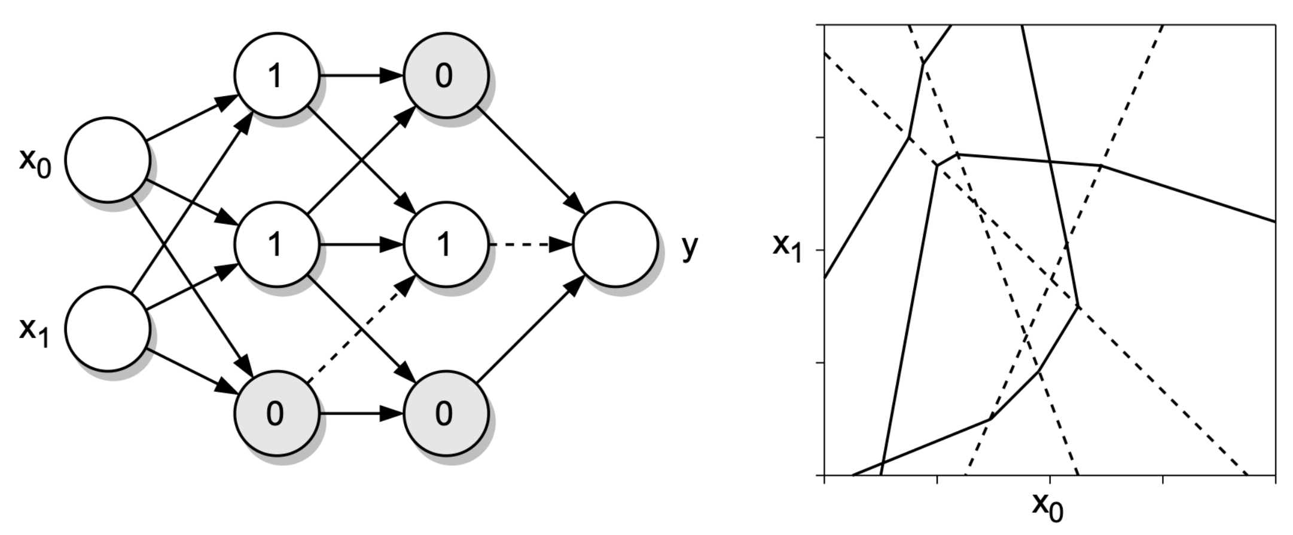
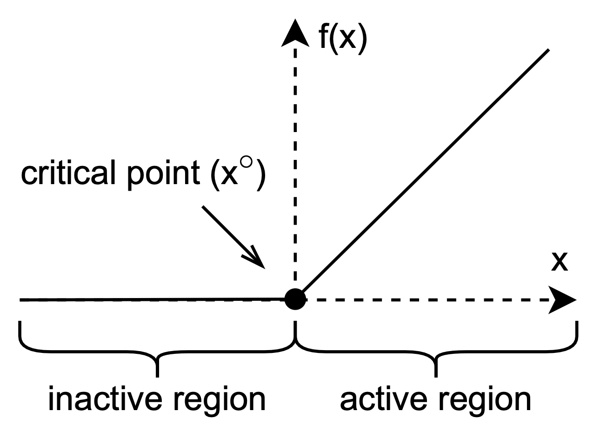
Properties of DNNs: Geometry
We consider the ReLU activation function.
Each ReLU function induces a (p-1)-dimensional hyperplane in the p-dimensional input space.
  A hyperplane consists of the points in the input space such that the corresponding ReLU is at its critical point.
  Hyperplanes split the input space into disjoint linear regions.
Notes:
We leverage the special properties of deep neural networks to launch our attack.
The ReLU and other piece-wise linear activation functions are widely used in deep neural networks because they are simple and efficient. A ReLU is active if its input is positive, and inactive otherwise. As shown in the bottom-left figure, a ReLU is at the critical point if its input is zero.
Each ReLU induces a (p-1) dimensional hyperplane in the p-dimensional input space. A hyperplane consists of all points in the input space, such that the associated ReLU is at the critical point. All these hyperplanes partition the input space into disjoint linear regions.

Slide 9
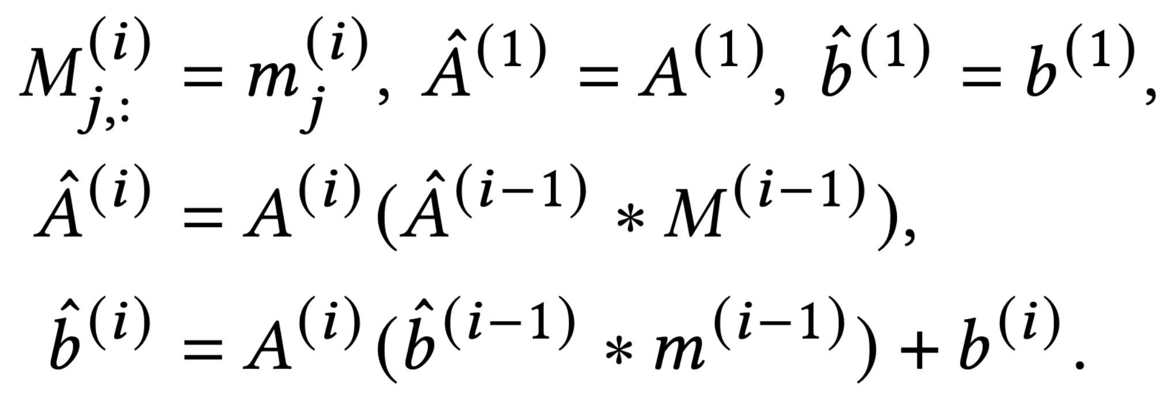
Properties of DNNs: Layers
The geometry of a hyperplane is determined by the parameters of the neurons in its preceding layers.
Notes:
The formulas in the bottom-left suggests an interesting property, which is, the geometry of a hyperplane is only determined by the parameters of the neurons in the preceding layers.
Therefore, a hyperplane in a subsequent layer will bend at the points where it intersects with a hyperplane in a preceding layer. In contrast, if two hyperplanes are in the same layer, they will not bend at the intersection.
An example of these hyperplanes are displayed in the bottom-right figure. The dashed lines are the hyperplanes of the first layer, so they are all straight. The solid lines are the hyperplanes in the second layer. They only bend at the points where they cross the lines of the first layer.
Later we will explain how to use these properties to launch our attack.

Slide 10
Algorithm Overview
Our attack targets one hidden layer at a time.
It sequentially launches three attacking procedures for each layer:
  Key bit inference
  Learning attack
  Validation and correction
Notes:
Hi, I am Guannan Zhao. Next, I will introduce our attacking algorithm in detail.
Our attacking algorithm targets one hidden layer at a time to minimize complexity. It moves to the next layer when it has validated all the extracted key values in the previous layer.
It launches three attacking procedures in a sequence for each hidden layer: the key bit inference procedure, the learning based attack, and the validation and correction procedure.

Slide 11
The Key Bit Inference Procedure (Witness)
Step 1: find a witness to the hyperplane induced by the targeted ReLU function.
  Randomly choose a line in the input space.
  Draw several samples along the line.
  Find two consecutive samples that yield opposite signs for the input value of the targeted ReLU function.
  Launch a binary search between the two samples until it finds a critical point for the ReLU function.
Notes:
First, the key bit inference procedure is a lightweight, algebraic approach to infer one key bit at a time.
The first step of the procedure is to find a point in the input space that is on the hyperplane of the targeted ReLU.
We draw a random line in the input space. The hyperplane should intersect with this line, because it has (p-1) dimensions.
We then draw several samples along the line. There should exist two consecutive samples that lead to opposite signs for the input of the targeted ReLU.
We launch a binary search on the line between the two samples, until we find a point corresponding to the critical point of the targeted ReLU.

Slide 12
The Key Bit Inference Procedure (Basis Vector)
Step 2: to extract the key bit associated with the j-th neuron in the i-th hidden layer, we need to find the j-th basis vector for that layer.
We can determine the key value by moving along the basis vector from a point (witness) on the associated hyperplane.
In practice, we find the pre-image of the basis vector with least squares.
Notes:
Intuitively, if we are moving in the active region of a ReLU function, the output should change accordingly. However, if we are moving in the inactive region, the output should remain unchanged.
In this way, we can infer the value of the key bit.
To suppress the impacts of other neurons in the same layer, we need to find the basis vector of the targeted neuron.
In practice, we use the least-square method to solve for the basis vector.

Slide 13
The Key Bit Inference Procedure (Sensitization)
Can we always find a basis vector?
  Depending on whether the architecture of the DNN is “expansive”.
Can we always observe the change from primary outputs?
  As long as there exists a path from the neuron to the output node, such that all the ReLU functions along the path are active.
Notes:
Is this procedure always feasible?
On the one hand, we need to find a basis vector. Whether a basis vector exists depends on the dimensionality of the hidden layer. Typically, if the network is expansive, we cannot find a basis vector.
On the other hand, we need to observe the change from the output vector of the entire deep neural network. In practice, we can almost always observe the change, because a sensitizable path nearly always exists.

Slide 14
The Learning Attack Procedure
The learning attack is launched on the remaining key bits.
  Treat every key bit as a learnable parameter.
  Substitute each key bit with a sigmoid function, whose range is [-1,+1].
  Generate random input samples and query the oracle for corresponding outputs.
  Fix a key bit to -1 or +1 when it is close to the range boundary.
Notes:
The second procedure is called the learning attack. We launch this attack on all those key bits where the key bit inference procedure has failed.
In specific, we treat each of these key bits as a learnable parameter, and substitute it with a sigmoid function. We then generate the training data by querying the oracle model. Once the value of a key bit is close enough to either negative 1 or positive 1, we fix it to that number.

Slide 15
The Validation and Correction Procedure
If all the key values of a hidden layer are correct, the hyperplanes of the neurons in the next hidden layer must overlap with those of the oracle.
If they do not overlap, the algorithm attempts to flip the learned key bits in an ascending order of their absolute values.
Notes:
Some of the key bits may still be unknown after the above two procedures. In this case, we simply guess their values according to the learning results. If the guess is correct, the hyperplanes in the next hidden layer must overlap with those of the oracle model. This overlap can be verified efficiently and reliably.
If the guess is incorrect, we flip the key bits in an ascending order of their absolute values. Once all the key bits on a hidden layer are verified to be correct, we proceed to the next hidden layer. Finally, we can extract all the key bits, and therefore restore the original functionality of the deep neural network.

Slide 16
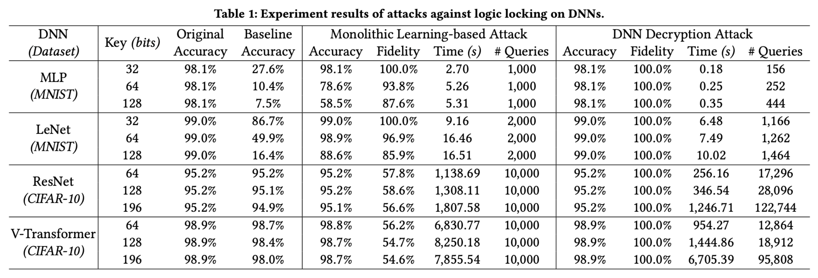
Evaluation
Notes:
This table shows our evaluation results. We test our attacking algorithm on different neural network architectures including large and complex ones like the vision transformer. For all the cases, our attack can recover all the key bits correctly. This implies that the existing logic locking methods are not secure on deep neural networks.
Our future work will focus on two directions. First, we will study how to enhance the security on the functional level. Second, we will investigate how to leverage hardware root-of-trust on AI accelerators to improve the security.

