Slide 2


SE3: Sequential Equivalence Checking for Non-Cycle-Accurate Design Transformations
Northwestern University, USA
You Li*, Guannan Zhao*, Yunqi He and Hai Zhou
*Equal Contribution
Notes:
Hi, in this presentation, we will discuss a symbolic model checking algorithm which verifies whether two systems are equivalent modulo timing differences. I am You Li, and this work is done in collaboration with Guannan Zhao and supervised by Prof. Hai Zhou.

Slide 3
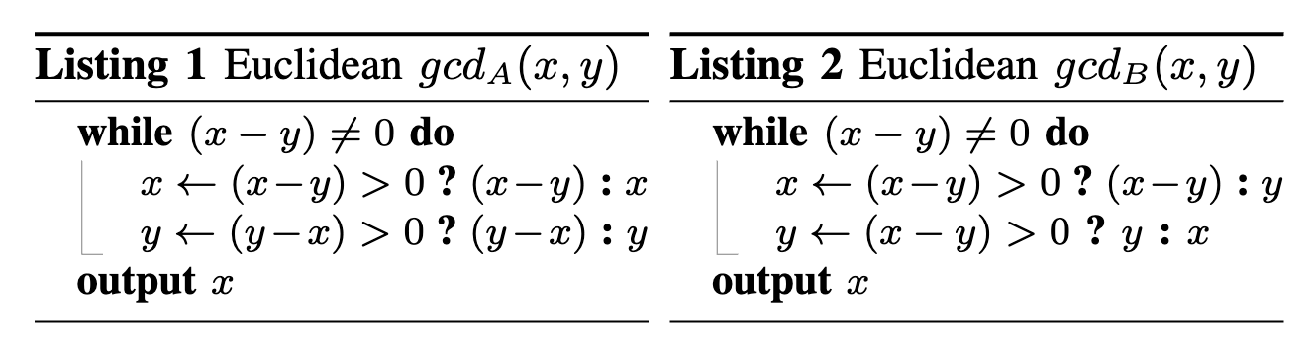
Motivating Example: Euclid’s Algorithm
  The Euclid’s Algorithm computes the Greatest Common Divisor of two integers.
    gcd_{A} initiates 2 subtraction operations in each clock cycle.
    gcd_{B} initiates 1 subtraction operation in each clock cycle.
gcd_{A}:
⟨6, 10⟩
⟨6, 4⟩
⟨2, 4⟩
⟨2, 2⟩
gcd_{B}:
⟨6, 10⟩
⟨10, 6⟩
⟨4, 6⟩
⟨6, 4⟩
⟨2, 4⟩
⟨4, 2⟩
⟨2, 2⟩
Notes:
Let’s start with a motivating example. The Euclid’s algorithm computes the greatest common divisor of two integers. The first design, gcd-A, conducts two subtraction operations in each iteration. It always subtracts the smaller integer from the greater one. The second design, gcd-B, conducts only one subtraction operation in each iteration. If x is greater than y, it subtracts y from x. Otherwise, it switches x and y.
Suppose the initial values of x and y are 6 and 10. As you can see, the two designs are different in timing.

Slide 4
Non-cycle-accurate Design Transformations
Design engineers and optimization tools are performing aggressive design transformations to meet the increasing timing and throughput demands.
In high-level synthesis and RTL optimization:
  Retiming, pipelining, pre-computation, etc.
As a design methodology:
  Dynamic scheduling, latency-intensive (LI) interface
gcd_{A}:
⟨6, 10⟩
⟨6, 4⟩
⟨2, 4⟩
⟨2, 2⟩
gcd_{B}:
⟨6, 10⟩
⟨10, 6⟩
⟨4, 6⟩
⟨6, 4⟩
⟨2, 4⟩
⟨4, 2⟩
⟨2, 2⟩
Notes:
If we enforce an alignment of the internal states, we can see that gcd-A and gcd-B have variable periods with respect to each other. Existing sequential equivalence checking methods assume that the two designs are cycle-accurate or they have fixed periods. However, modern design tools are performing even more aggressive design transformations to meet the increasing PPandA demands. For example, high-level synthesis tools and RTL optimization tools can perform retiming, pipelining, pre-computation etc. Additionally, modern design methodologies such as dynamic scheduling and latency intensive interface can also produce designs with variable periods. An efficient equivalence checking algorithm is the key enabler for non-cycle-accurate design transformations.

Slide 5
Observational Equivalence modulo Stuttering
Two designs A and B are observational equivalent modulo stuttering, if there exists a way to insert stuttering steps such that the two designs produce the same output sequence.
  Normal mode (output is produced only when x=y):
  Debugging mode (always outputs the smaller value):
gcd_{A}:
⟨6, 10⟩
⟨6, 4⟩
⟨2, 4⟩
𝜏
𝜏
𝜏
⟨2, 2⟩
gcd_{B}:
⟨6, 10⟩
⟨10, 6⟩
⟨4, 6⟩
⟨6, 4⟩
⟨2, 4⟩
⟨4, 2⟩
⟨2, 2⟩
gcd_{A}:
⟨6, 10⟩
𝜏
⟨6, 4⟩
𝜏
⟨2, 4⟩
𝜏
⟨2, 2⟩
gcd_{B}:
⟨6, 10⟩
⟨10, 6⟩
⟨4, 6⟩
⟨6, 4⟩
⟨2, 4⟩
⟨4, 2⟩
⟨2, 2⟩
Notes:
We say that two designs are observational equivalent modulo stuttering, if there exists a way to insert stuttering steps, such that the two designs always output the same value at the same clock cycle.
We first consider the normal mode. In this mode, only the final state is observable. A naïve way is to insert stuttering steps only before the final state. Alternatively, suppose that in the debugging mode, all states are observable, and the smaller integer between x and y is sent to the primary output. In this case, one need to insert a stuttering step to the faster design in every few steps to wait for the slower design.

Slide 6
Product Machine for Stuttering
Without loss of generality, suppose that design A is always no slower than design B.
The product machine uses a dummy input (sel) to insert stuttering steps to design A.
If A and B are equivalent modulo stuttering,
there must exist an input sequence of sel
such that the outputs of A and B are always
the same.
A moves forward,
B moves forward
sel
A stutters,
B moves forward
Notes:
Suppose that design A is always no slower than design B. This is the case when A is a high-level specification and B is a low-level implementation, or A is optimized from B. Then we can construct a product machine for stuttering. This machine consists of two branches. For the first branch, both A and B move forward, and for the second branch, only B moves forward. The product machine uses a dummy input, SEL, to select from these two branches. When SEL equals 1, a stuttering step is inserted to A.
If A and B are equivalent modulo stuttering and there are no deadlocks, there must be a sequential assignment to SEL such that A and B always produce identical outputs until termination.
In the more general case that both A and B can be slower than each other, we add a third branch to the product machine, where only A moves forward.

Slide 7

Lasso-shaped Path
6,4,4,6
sel=0
sel=1
2,4,6,4
6,4,6,4
We attach a self-loop to all termination states.
Given a valid input sequence of sel, there must be a lasso-shaped infinite path in the state transition graph of the product machine. All states along the path satisfy observational equivalence.
One could use a fairness checker like FAIR or k-liveness to check the existence of such a lasso-shaped path.
2,4,2,4
6,4,2,4
2,2,4,2
2,4,4,2
2,2,2,2
2,4,2,2
State transition graph of the product machine.
(x_{A}, y_{A}, x_{B}, y_{B})
A lasso.
Notes:
Now let’s investigate the execution paths of the product machine.
A state of the product machine is called a termination state, if both A and B reach termination in that state. For example, in the top-right figure, the state (2,2,2,2) is a termination state. We attach a self-loop to all the termination states. A valid input sequence of SEL produces a lasso-shaped infinite path in the state transition graph of the product machine, such that all states along the path satisfy observational equivalence.
In the top-right figure, the highlighted states outline a lasso-shaped infinite path and all states along the path satisfy observational equivalence. This figure assumes that both designs are in the debugging mode, where they output the smaller integer between x and y in every intermediate state. In fact, in the normal mode, there will be more states satisfying observational equivalence, and thus more valid lasso-shaped paths.
In principle, we can directly use a fairness checker to check whether such a path really exists.

Slide 8
Alternation of Quantifiers
Unfortunately, a sequential circuit takes primary inputs periodically.
The verification problem then becomes: for any input sequence, there must exist a sequential assignment to sel, such that A and B are observationally equivalent.
This problem involves quantifier alternation.
There may exist exponential number of input sequences, so it is intractable to enumerate all of them. On the other hand, quantifier elimination can result in a formula that is exponential in size.
Notes:
A sequential circuit can take primary inputs, so our equivalence checking algorithm should also account for the uncertainties of input sequences.
Two designs are equivalent modulo stuttering if for any input sequence, there exists a sequential assignment to SEL, such that the outputs of both designs are always identical.
However, this problem involves quantifier alternation. Eliminating either the universal or the existential quantifier can result in a formula that is exponential in size.

Slide 9
Proof by Induction
A sequential circuit can be treated as a finite-state transition system, where:
  I represents the initial state,
  P represents the safety property to be checked,
  T represents the transition relation.
The safety property P always holds with respect to I, if there exists a formula Inv, such that
Inv is called the inductive invariant.
Notes:
Let’s consider the problem in another way. Induction is a powerful tool to prove that a finite-state transition system satisfies a safety property. A sequential circuit is also a transition system, where I represents the initial state, P represents the safety property to be checked, and T represents the one-step transition relation. The transition system is safe if there exists an inductive invariant INV, such that all states in I are also in INV, that INV itself is a fixed point, and that all states in INV are also in P.
Intuitively, the inductive invariant guarantees that any state violating the safety property is never reachable from the initial states.

Slide 10
Inductive Invariant for Stuttering
We construct a finite state transition system for stuttering as:
  I× encodes both a) the initial state and b) the input sequence consumed by the sequential circuit throughout its execution.
  P× represents the observational equivalence property.
  T_{syn} is the branch of the product machine, where both A and B move forward.
  T_{stu} is the branch of the product machine, where A stutters and B moves forward.
P× always holds with respect to I×, if there exists a formula Inv×, s.t.
Inv× is called the inductive invariant for stuttering. If an Inv× exists, the two designs are observational equivalent modulo stuttering.
Notes:
We adapt the idea of proof-by-induction to check observational equivalence modulo stuttering. We construct a product machine modulo stuttering, where I-product encodes both the initial state and the primary input sequence, P-product represents the observational equivalence property, T-synchronize represents the synchronized branch of the product machine where both A and B move forward, and T-stuttering represents the stuttering branch where only B moves forward. If there exists an inductive invariant modulo stuttering, INV-product, such that every INV-product state has at least one INV-product successor from the two branches, then the two designs are observational equivalent modulo stuttering.
Why? Intuitively, every primary input sequence is encoded into an initial state of the system. Condition (b) ensures that from every initial state, there exist a lasso-shaped infinite path. Condition (c) ensures that all the states along the path satisfy observational equivalence.

Slide 11

A Caveat: Conjunction of Clauses
IC3 is the state-of-the-art invariant-based model checking algorithm.
IC3 maintains a formula F which is a conjunction of clauses. It iteratively add new clauses to F until it becomes an inductive invariant.
A clause c can be added to F if it is relatively inductive to F:
As for the inductive invariant for stuttering, above condition becomes:
  Unlike in IC3, if two clauses c₁ and c₂ are both relatively inductive to F, their conjunction c₁ ∧ c₂ may not be relatively inductive to F !
Notes:
IC3 is the state-of-the-art symbolic model checking algorithm that can search for an inductive invariant. IC3 maintains a formula F during its execution. It incrementally conjoins new clauses to F until F becomes an inductive invariant. A new clause c can be conjoined with F, if F and c and transition T implies c–prime. Here c-prime is the next-state version of c.
Now consider our problem of finding the inductive invariant for stuttering. In our case, even if two clauses c1 and c2 are both relatively inductive to F, their conjunction may not be relatively inductive to F due to the disjunction operator!
Next, we will explain how to resolve this issue.

Slide 12
The Reversed Approach
We adopt a reversed approach to bypass the disjunction operator.
  Switch the roles of I× and P×.
  Reverse the directions of T_{syn} and T_{stu} by switching their current state variables and next state variables.
Inv○ is called the reversed inductive invariant for stuttering. If an Inv○ exists, the two designs are observational equivalent modulo stuttering.
Notice that formula (b) has no disjunction operators.
Notes:
Hi, I am Guannan Zhao. In the following, I will explain our reversed approach to get rid of the disjunction operator. The original problem checks whether the negation of P-product is reachable from any I-product states. Here we switch the roles of I-product and P-product. Also, we reverse the directions of T-synchronize and T-stuttering by switching the current and the next state variables for each branch. The new problem checks whether I-product is backward reachable from any not-P-product states.
Notice that the new formula (b) has no disjunction operators in it.

Slide 13
The Reversed Approach
If an Inv○ exists, the two designs are observational equivalent modulo stuttering.
  For a tree whose leaf nodes are all (¬P×)-states, its root node must not be an (I×)-state.
  Therefore, from every (I×)-state there must exist a lasso-shaped infinite path, such that all states along the path satisfy P×.
We also proved in our paper that Inv× is an inductive invariant for stuttering iff Inv○= ¬Inv× is a reversed inductive invariant for stuttering.
I×
Inv○
¬P×
Notes:
If an INV-circle exists, design A and design B are observational equivalent modulo stuttering. Why? Remember that the state transition graph of the product machine has a tree structure. Condition (b) states that, sa and sb are both successor states of s. It ensures that if sa and sb are both INV-circle-states, s should also be an INV-circle-state. Condition (c) ensures that all the INV-circle-states are not-I-product states. Therefore, a tree in the state transition graph, whose root node is an I-product state and whose leaf nodes are all not-P-product states, cannot exist. As a result, from every state in I-product, there must exist a lasso-shaped infinite path, such that all states along the path satisfies observational equivalence.
We also proved in the paper that INV-product is an inductive invariant for stuttering if and only if the negation of INV-product is a reversed inductive invariant for stuttering.

Slide 14
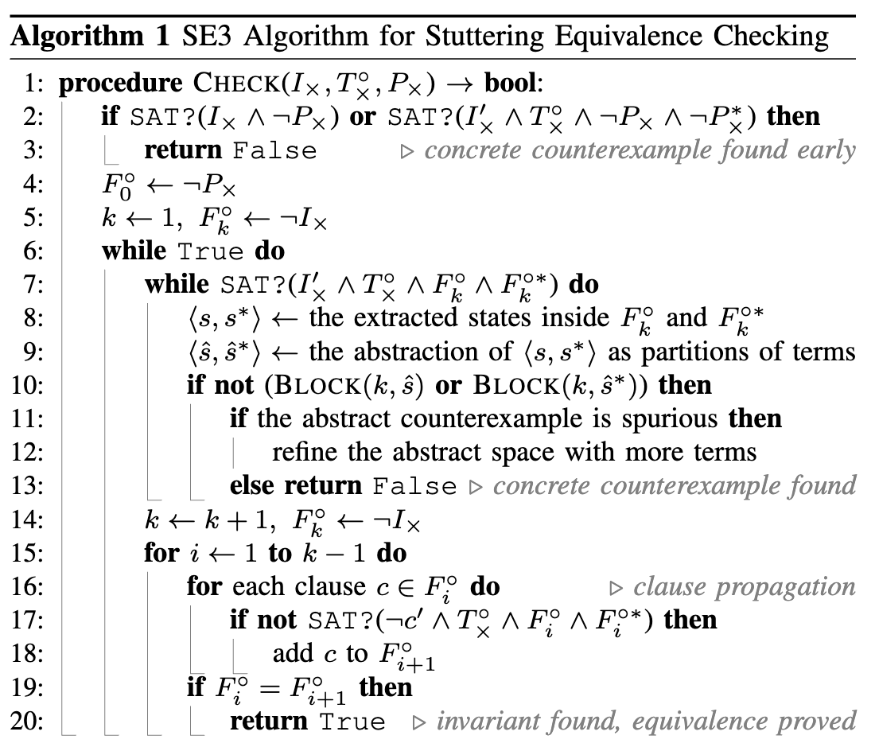
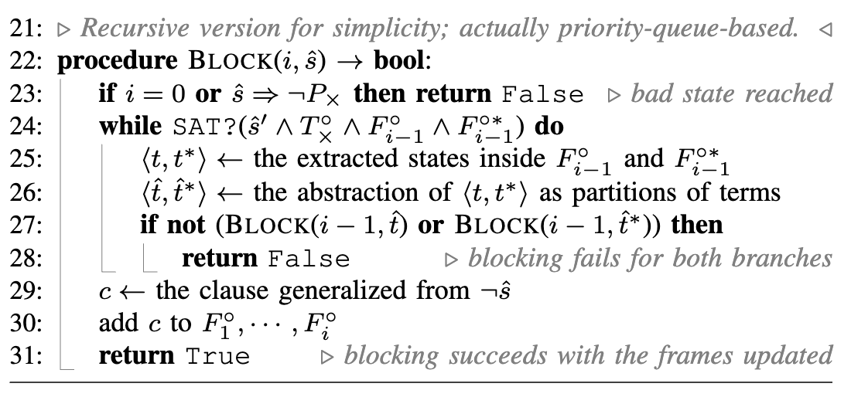
From IC3 to SE3
In the style of IC3, SE3 checks whether two designs are observational equivalent modulo stuttering.
  If so, it finds an inductive invariant.
  If not, it finds a counterexample tree.
SE3 adapts several optimization techniques from IC3.
  e.g., clause generalization & propagation.
SE3 leverages word-level abstractions to improve scalability.
Notes:
We now briefly discuss our SE3 algorithm.
If the two designs under verification are observational equivalent modulo stuttering, SE3 will eventually find an inductive invariant and return true. On the contrary, if the two designs are not equivalent, SE3 will return false and find a counterexample tree, which basically means the observational equivalence will be eventually violated on all branches of the tree. SE3 adapts several optimization techniques from IC3, such as clause generalization and propagation, to speed up the execution.
Furthermore, we leverage word-level abstractions to make SE3 more efficient on large sequential circuits.

Slide 15
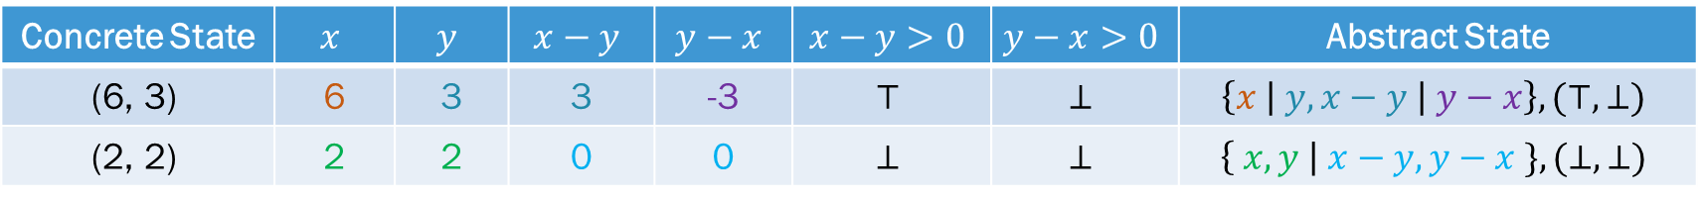
Syntax-guided Abstraction
Concrete State | $$x$$ | $$y$$ | $$x−y$$ | $$y−x$$ | $$x−y>0$$ | $$y−x>0$$ | Abstract State
$$\text{(6, 3)}$$ | 6 | 3 | 3 | -3 | $$⊤$$ | $$⊥$$ | $$\left\{x \right| y, x−y \left| y−x\right\}, (⊤, ⊥)$$
$$\text{(2, 2)}$$ | 2 | 2 | 0 | 0 | $$⊥$$ | $$⊥$$ | $$\left\{ x,y \right| x−y, y−x \}, (⊥, ⊥)$$
Syntax abstraction creates an abstract space using a subset of the terms/atoms present in the original model.
  An abstract state is a partition assignment which captures Boolean values of atoms and equality relations among terms.
  Syntax abstraction removes irrelevant bit-level details and scales well to large word sizes.
If a spurious counterexample is found, SE3 investigates the unsat core and adds new terms/atoms to eliminate the counterexample.
Notes:
Specifically, we use syntax abstraction to map bit-level concrete states into word-level abstract states. An abstract state is a partition assignments of a subset of the terms and atoms used by the original model.
We give some examples of syntax abstraction in the table. As you can see, an abstract state consists of two parts. The first part are the terms grouped by equality, and the second part are the values of Boolean expressions. By doing so, it removes irrelevant bit-level details and scales well to large word sizes.
Due to the abstraction, SE3 may find spurious counterexamples during execution. When this happens, SE3 introduces new terms and atoms to eliminate the counterexamples. Leveraging this strategy, SE3 iteratively refines the abstract domain for reasoning until it can make a conclusion.

Slide 16
Compare SE3 with KAIROS
They are complementary to each other.
SE3 is efficient as a verifier, whereas KAIROS + BMC is efficient to find counterexamples.
Alignment of state sequences (normal mode) using KAIROS
gcd_{A}:
⟨6, 10⟩
⟨6, 4⟩
⟨2, 4⟩
⟨2, 2⟩
𝜏
𝜏
𝜏
gcd_{B}:
⟨6, 10⟩
⟨10, 6⟩
⟨4, 6⟩
⟨6, 4⟩
⟨2, 4⟩
⟨4, 2⟩
⟨2, 2⟩
Alignment of state sequences (normal mode) using SE3
gcd_{A}:
⟨6, 10⟩
𝜏
⟨6, 4⟩
𝜏
⟨2, 4⟩
𝜏
⟨2, 2⟩
gcd_{B}:
⟨6, 10⟩
⟨10, 6⟩
⟨4, 6⟩
⟨6, 4⟩
⟨2, 4⟩
⟨4, 2⟩
⟨2, 2⟩
Notes:
As a case study, we compare SE3 with Kairos, the most recent work on non-cycle-accurate equivalence checking. Interestingly, we observe that they complement each other. While SE3 is more efficient in verifying equivalence, Kairos tends to find counterexamples more quickly for non-equivalent cases.
We believe this is because they align state sequences in different ways. For example, when only the final state is observable, Kairos simply inserts all stuttering steps in the end. On the contrary, SE3 can freely choose where to insert stuttering steps, resulting in a better alignment for syntax abstraction. This advantage becomes more significant as the word size grows. For the same reason, if the two systems are not equivalent, SE3 needs to spend more time to choose branches until a counterexample tree is found.

Slide 17
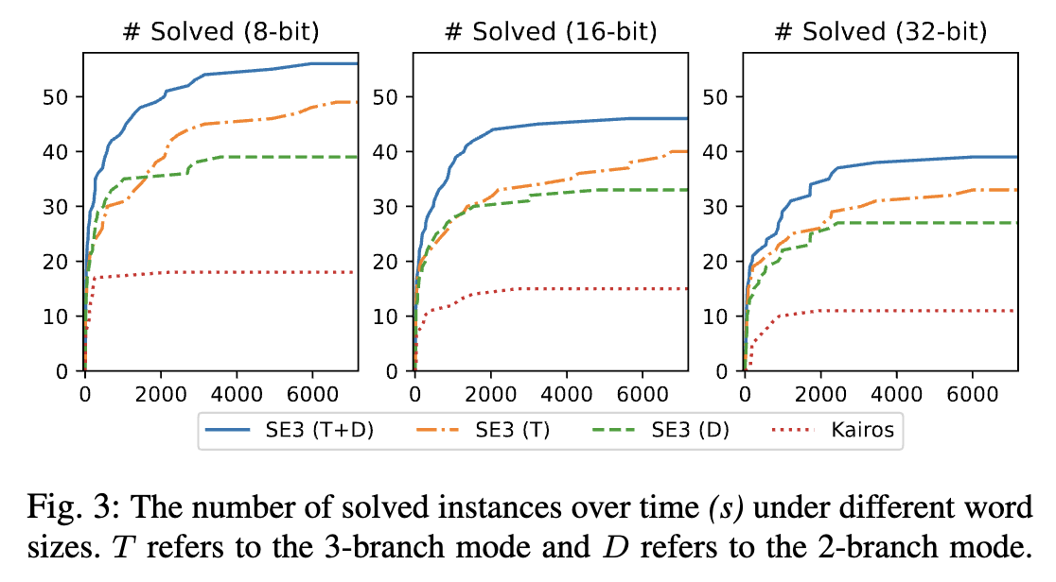
Evaluation
Notes:
Finally, we evaluate the performance of SE3 and Kairos on a high-level synthesis benchmark suite for different word sizes up to 32 bits. Leveraging the Xilinx Vivado HLS, we apply a variety of sequential transformations to generate pairs of non-cycle-accurate designs. We also compare the two different modes of SE3. The 2-branch mode assumes that one design is always no slower than the other, and the 3-branch mode does not make this assumption.
As shown in the figure, in either modes, SE3 can solve more instances than Kairos. Specifically, the 2-branch mode is the fastest when it is applicable, while the 3-branch mode can be applied to more general cases. Hence, a combination of the two modes running in parallel can solve the largest number of instances. We can also see that SE3 scales well with respect to the word size. These experimental results confirm the effectiveness and correctness of SE3.
Thanks for watching.

Slide 18
References
FAIR: An incremental approach to model checking progress properties. Bradley, Aaron R and Somenzi, Fabio and Hassan, Zyad and Zhang, Yan. FMCAD 2011.
K-liveness: A liveness checking algorithm that counts. Claessen, Koen and Sorensson, Niklas. FMCAD 2012.
IC3: SAT-based model checking without unrolling. Bradley, Aaron R. VMCAI 2011.
Model checking of Verilog RTL using IC3 with syntax-guided abstraction. Piccolboni, Luca, Goel, A. and Sakallah, K.. NFM 2019.
KAIROS: Incremental Verification in High-Level Synthesis through Latency-Insensitive Design. Piccolboni, Luca, Giuseppe Di Guglielmo, and Luca P. Carloni. FMCAD 2019.

Slide 19
The Reversed Approach
We adopt a reversed approach to bypass the disjunction operator.
  Switch the roles of I× and P×.
  Reverse the directions of T_{syn} and T_{stu} by switching their current state variables and next state variables.
Inv○ is called the reversed inductive invariant for stuttering:
We have proved in our paper that Inv× is an inductive invariant for stuttering if and only if Inv○= ¬Inv× is a reversed inductive invariant for stuttering.
Our problem is hence reduced to incrementally finding an Inv○ like IC3.
Notes:
We propose a reversed approach to get rid of this disjunction operator. The original problem checks whether the negation of P-product is reachable from any I-product states. Here we switch the roles of I-product and P-product. Also, we reverse the directions of T-synchronize and T-stuttering by switching the current and the next state variables for each branch. The new problem checks whether I-product is backward-reachable from any not-P-product states.
As you can see, the new formulas contain no disjunction operator.
/** SHORT VER **/
We have proved in the paper that INV-product is an inductive invariant for stuttering if and only if its negation is a reversed inductive invariant for stuttering. In other words, if an INV-circle exists, then the two designs are observational equivalent modulo stuttering. With this conclusion, our problem can be now solved with an algorithm inspired by IC3.
/** LONG VER **/
/* If an INV-circle exists, design A and design B are observational equivalent modulo stuttering. Why? Remember that the state transition graph of the product machine has a tree structure. Condition (b) states that, sa and sb are both successor states of s. It ensures that if sa and sb are both INV-circle states, s should also be an INV-circle state. Condition (c) ensures that all the INV-circle states are not-I-product states. Therefore, no tree can exist in the state transition graph whose root node is an I-product state and whose leaf nodes are all not-P-product states. As a result, from every state in I-product, there must exist a lasso-shaped infinite path which satisfies observational equivalence. */
/* In fact, as we have proved in the paper, INV-product is an inductive invariant for stuttering if and only if its negation is a reversed inductive invariant for stuttering. With this conclusion, we can now solve the equivalence checking problem with an algorithm inspired by IC3. */

